Slide 1
Object detection
Focus on good , good gets better ….

Slide 2
Table of contents :
Introduction
Classification
Localization
Vector Representation
CNN
YOLO
Flowchart

Slide 3
Introduction
Yolo is a object detection algorithm and it is so fast that it has become almost a standard way of detecting objects in the field of computer vision .

Slide 4
Cont..
Previously people were using sliding window object detection.
But in 2015 Yolo was invented that has outperformed all the previous object detection algorithms .

Slide 5
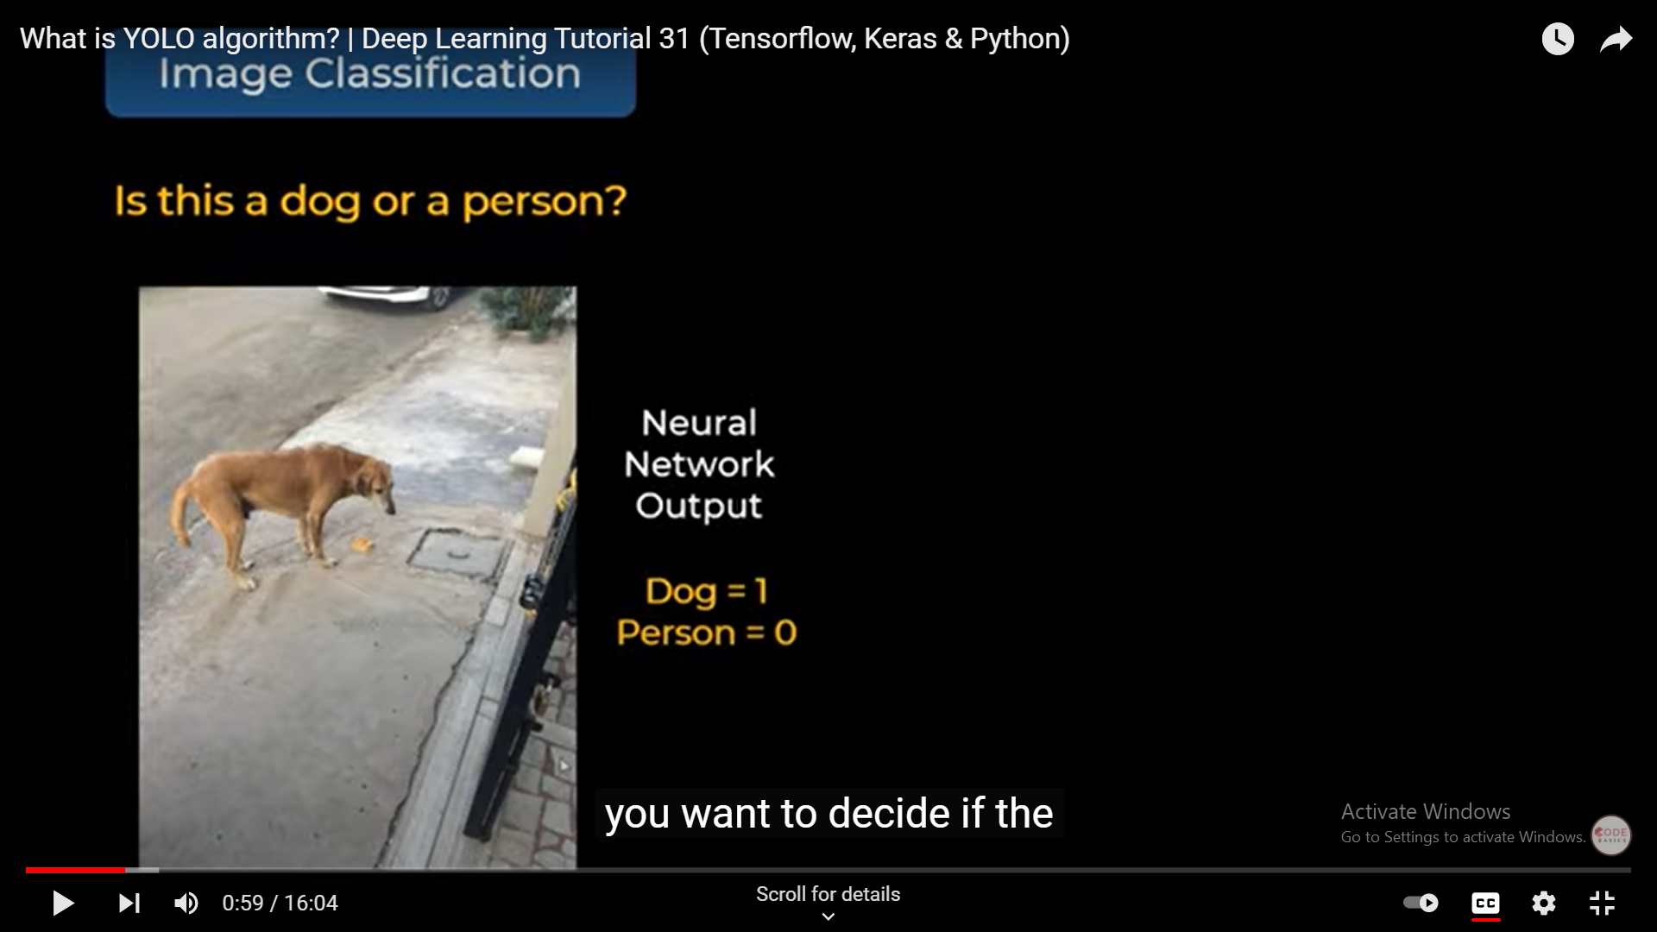
Image classification :
Neural
Network
Output
Dog =1
Person =o

Slide 6
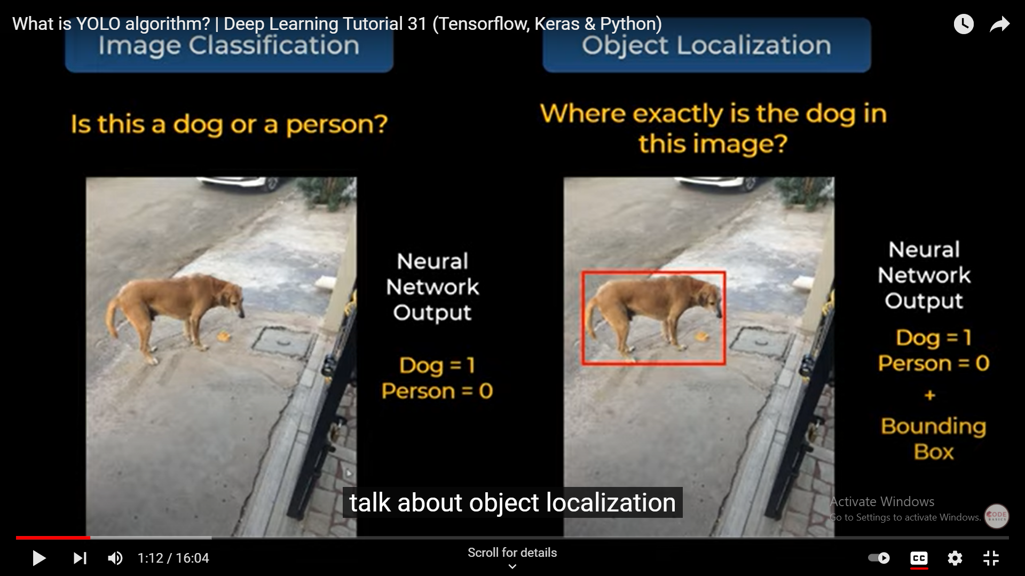
Object localization :
Here
Bounding boxes
are introduced .

Slide 7
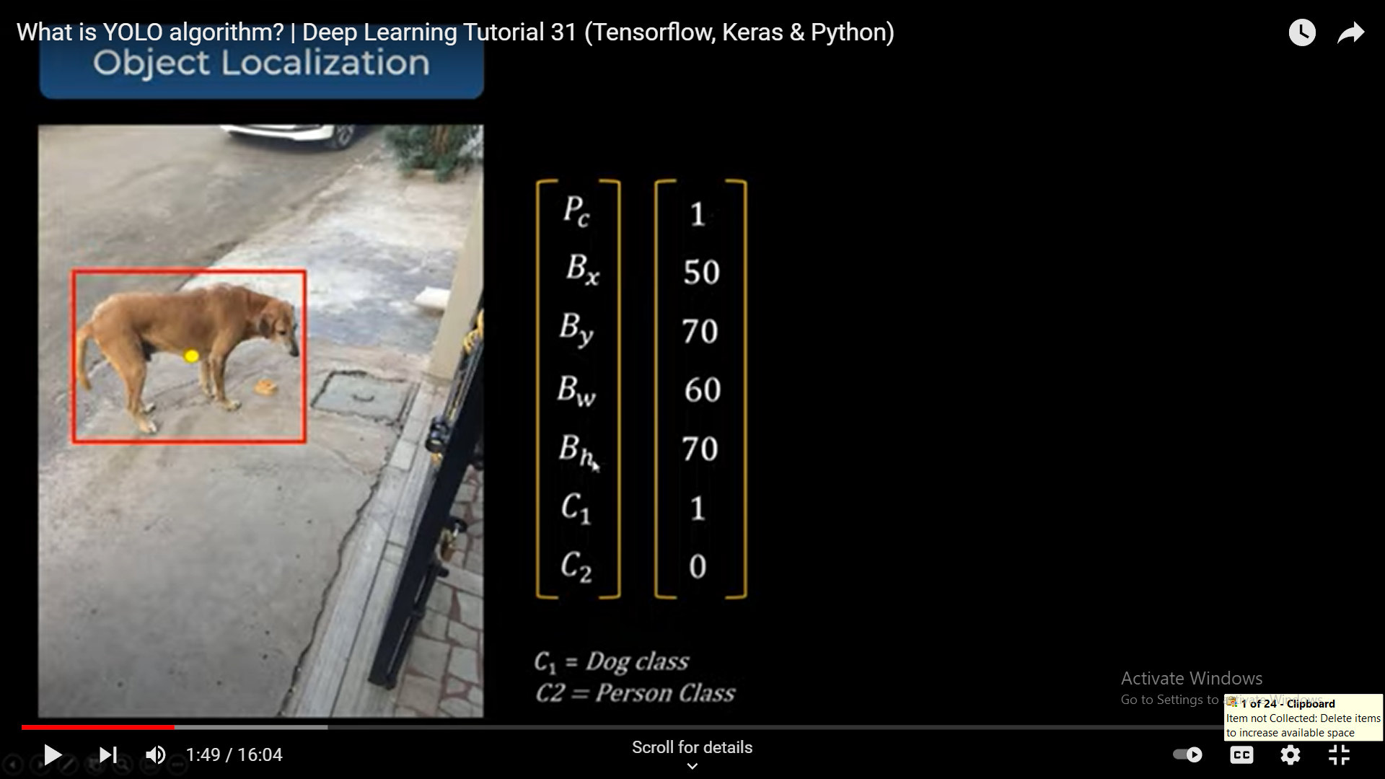
Vector representation
Here c1= Dog class , C2=person class

Slide 8
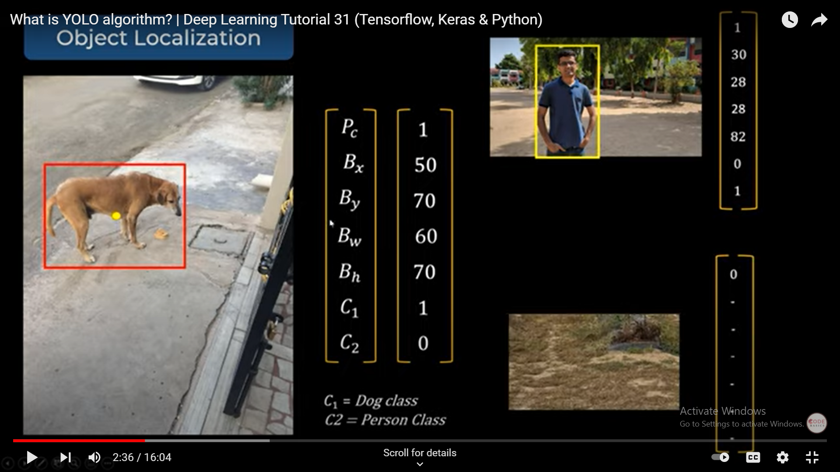
If there is no object
Only probability =0 . So,
remaining values will be
null
And vector values are
Represented here .

Slide 9
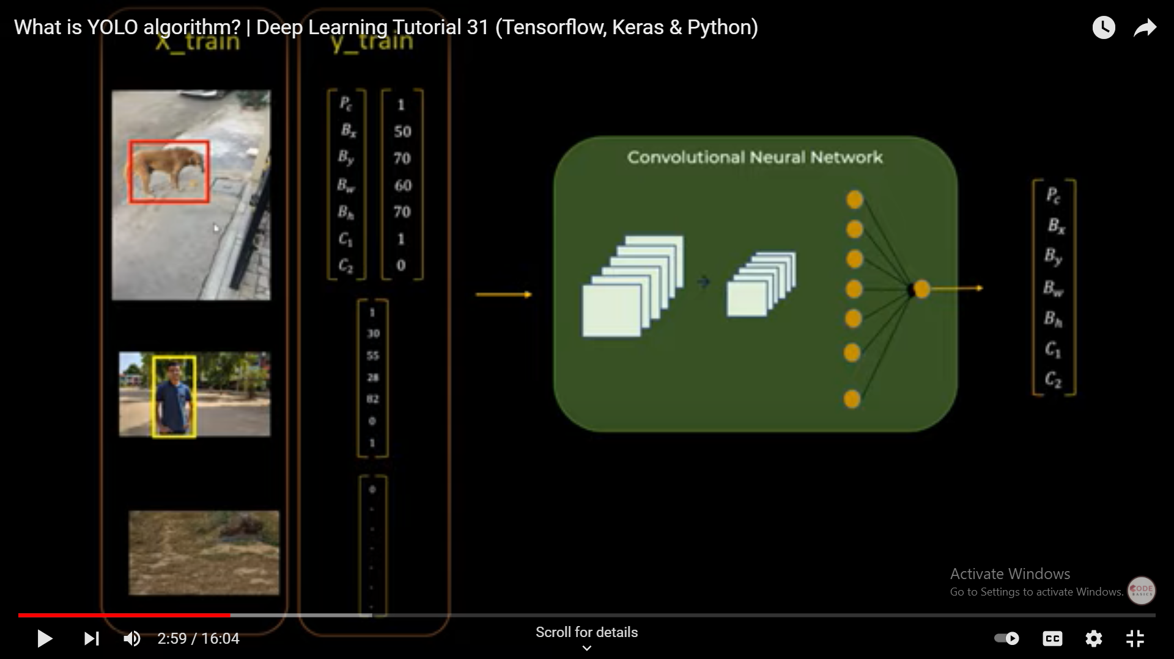
convolutional neural network
learning problem with bounding boxes

Slide 10
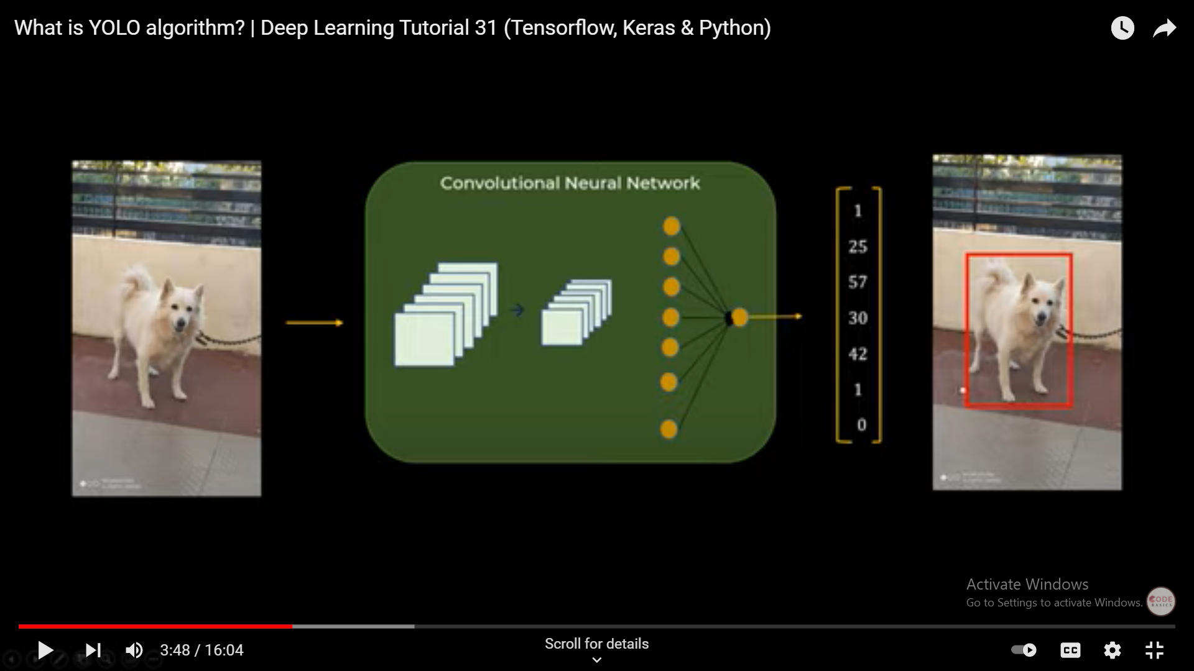
Only for single object in image

Slide 11
What about multiple objects :
What if there are two dogs and three people in an image !
So , its hard to determine the dimension of your neural network output.
If there are n objects , determining size of the output of neural network is hard .
So , we need another technique .

Slide 12
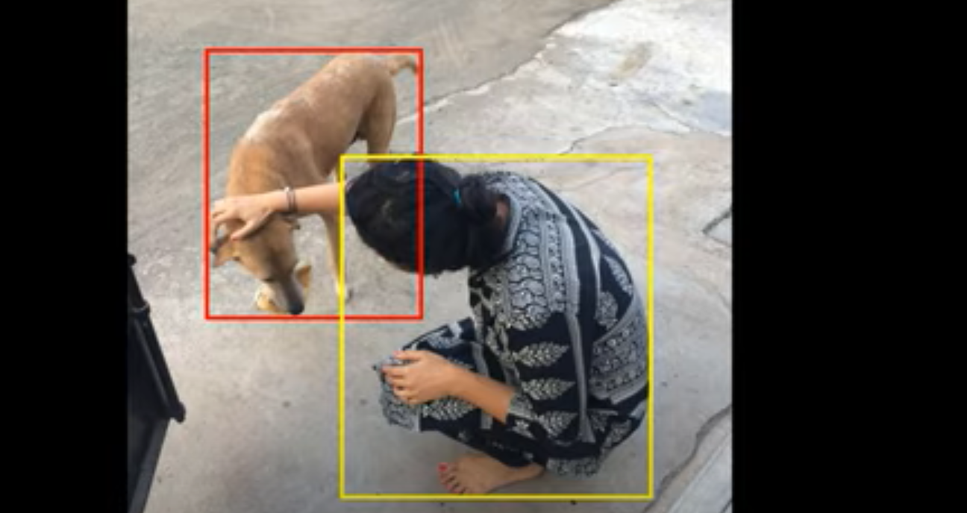
Multiple objects :

Slide 13
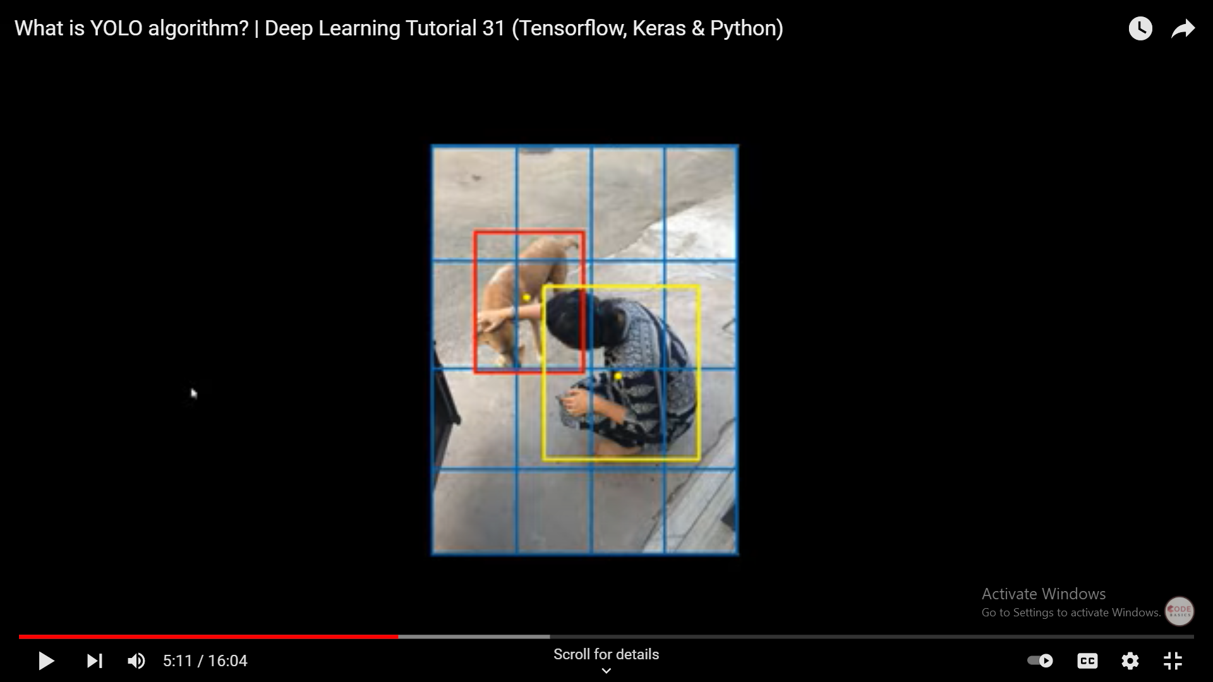
We use grid cells

Slide 14
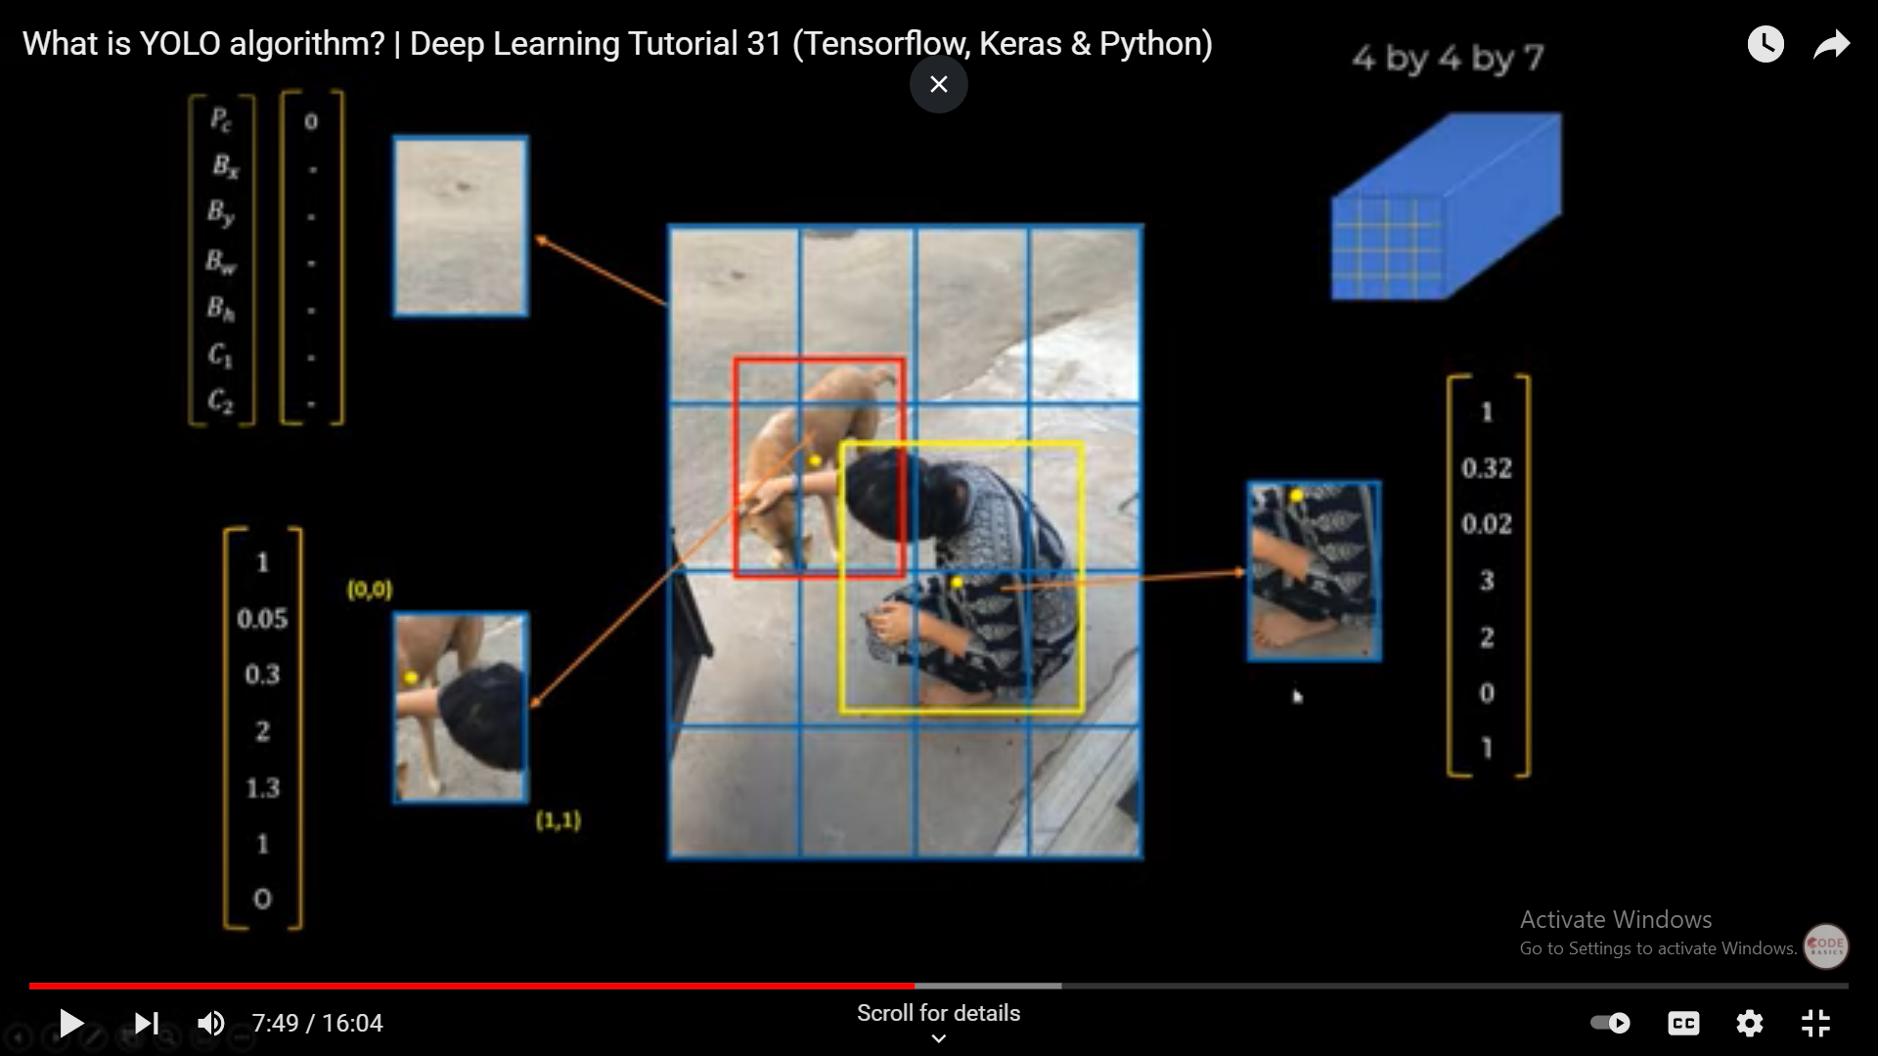

Slide 15
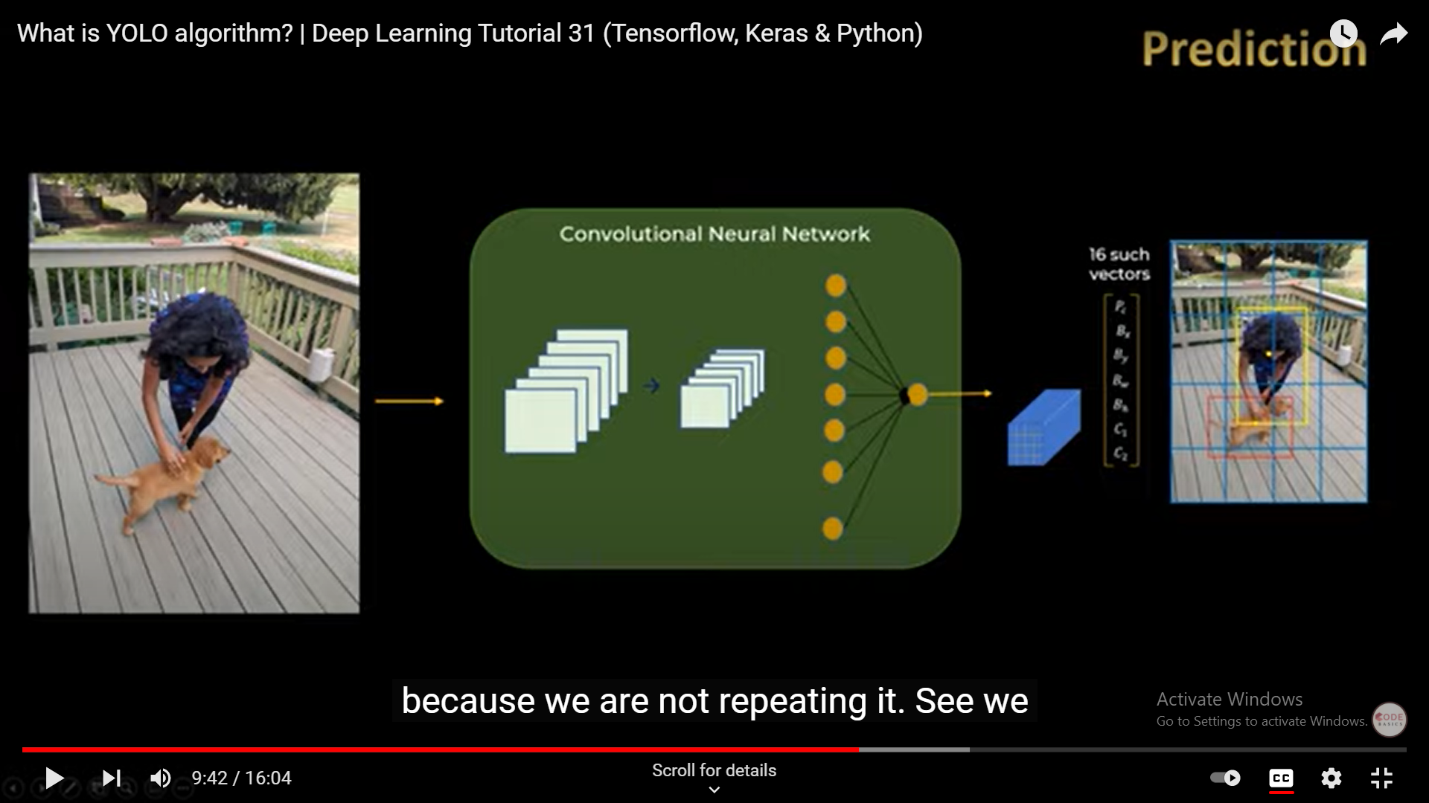
You only look once

Slide 16
Cont..
So this is YOLO algorithm, called you only look once .
Because we are not repeating it , so we are using 16 grids each one time ~16 times, instead of doing 60 iterations .
In one forward pass , you can make all the predictions

Slide 17
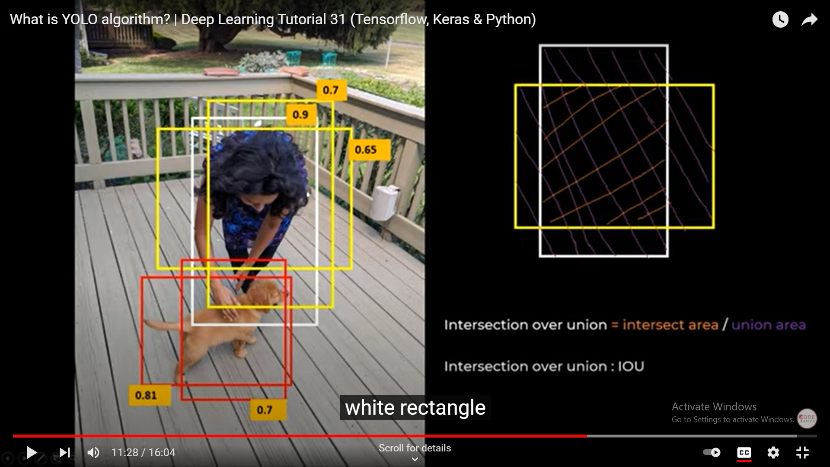

Slide 18
Can we just take max for each class
Concept of IOU :
So IOU is intersection over union – which is taking rectangle 0.9 and also take white rectangle as 0.81 .
Try to find overlapping area and area known as IOU .

Slide 19
Cont..
Intersection area union = intersected area/union area .
Intersection over union : IOU
Also known as non max suppression .
Neural network has detected all the objects you apply non max suppression and you get unique bounding boxes .

Slide 20
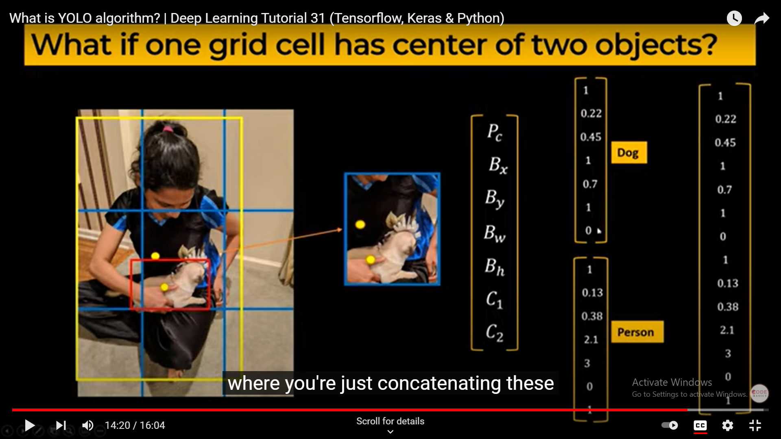
What if one grid has center of two objects :

Slide 21
Anchor boxes :
We just concatenate two vectors , basically two anchor boxes has been merged and then it will get your final output .

Slide 22
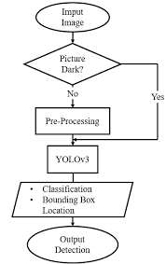
Flowchart:

Slide 23
You only look once (V3)
Never Look Twice.

Slide 24
“ Great things are not done by one person. They’re done by a team of people.”

